Slide 1
STAT3007: Introduction to Stochastic Processes
Conditional Probabilities and Expectations
Dr. John Wright

Slide 2
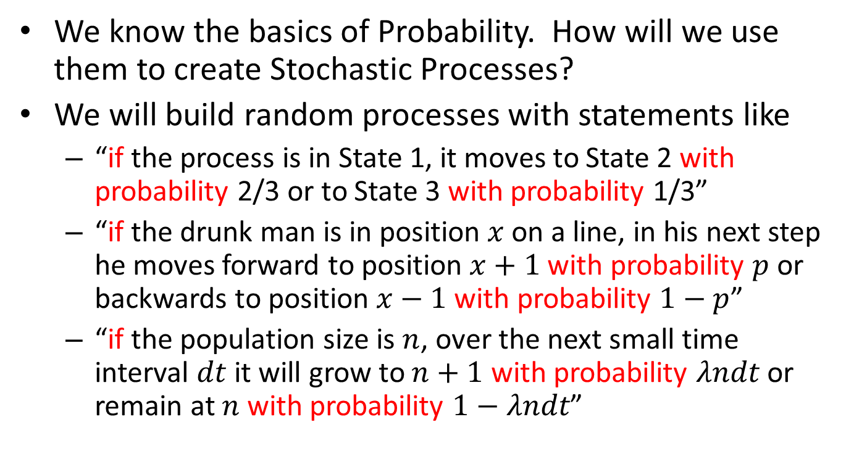
Conditional Probabilities and Expectations
We know the basics of Probability. How will we use them to create Stochastic Processes?
We will build random processes with statements like
“if the process is in State 1, it moves to State 2 with probability 2/3 or to State 3 with probability 1/3”
“if the drunk man is in position $x$ on a line, in his next step he moves forward to position $x+1$ with probability $p$ or backwards to position $x−1$ with probability $1−p$”
“if the population size is $n$, over the next small time interval $dt$ it will grow to $n+1$ with probability $λndt$ or remain at $n$ with probability $1−λndt$”

Slide 3
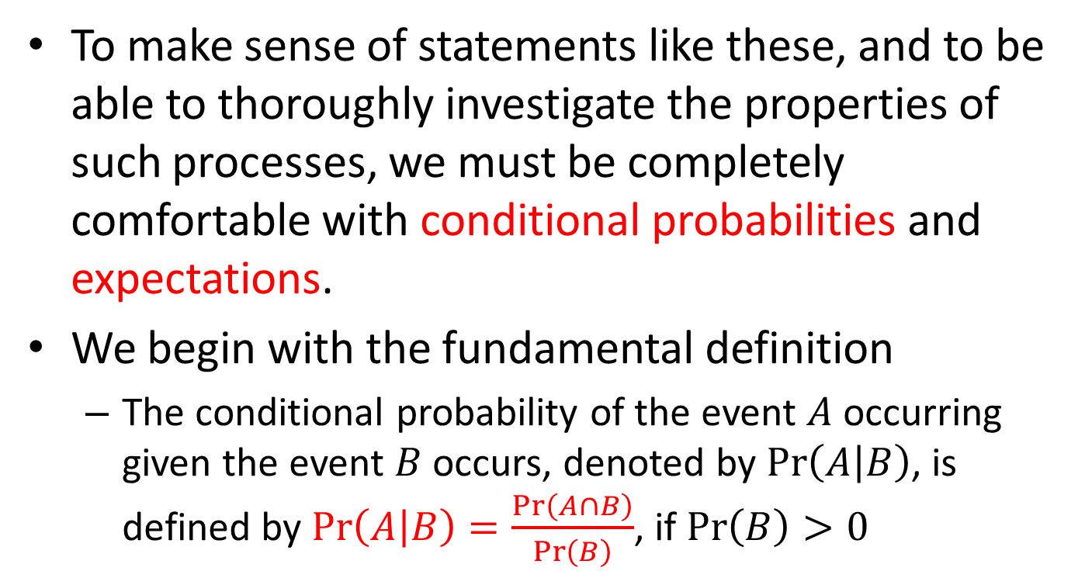
Conditional Probabilities and Expectations
To make sense of statements like these, and to be able to thoroughly investigate the properties of such processes, we must be completely comfortable with conditional probabilities and expectations.
We begin with the fundamental definition
The conditional probability of the event $A$ occurring given the event $B$ occurs, denoted by $\operatorname{Pr}\left(A | B\right)$, is defined by $\operatorname{Pr}\left(A | B\right)=\frac{\operatorname{Pr}\left(A∩B\right)}{\operatorname{Pr}\left(B\right)}$, if $\operatorname{Pr}\left(B\right)>0$

Slide 4
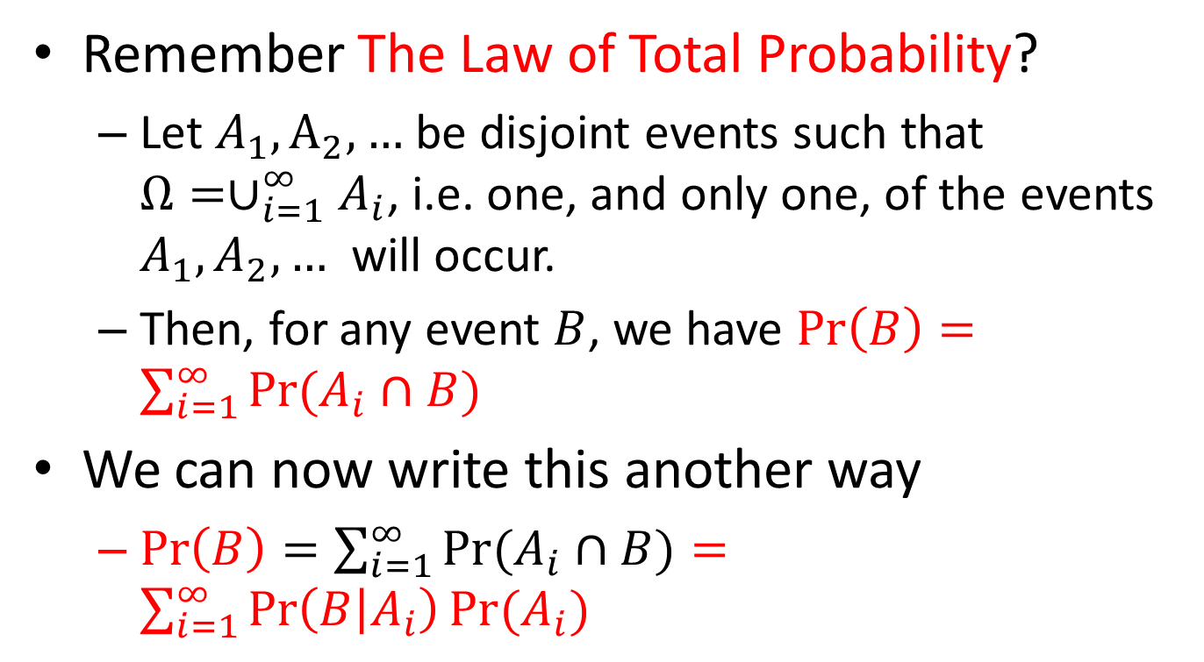
Conditional Probabilities and Expectations
Remember The Law of Total Probability?
Let $A_{1},A_{2},…$ be disjoint events such that $Ω=∪_{i=1}^{∞}A_{i}$, i.e. one, and only one, of the events $A_{1},A_{2},…$ will occur.
Then, for any event $B$, we have $\operatorname{Pr}\left(B\right)=\sum_{i=1}^{∞}{\operatorname{Pr}{(A_{i}∩B)}}$
We can now write this another way
$\operatorname{Pr}\left(B\right)=\sum_{i=1}^{∞}{\operatorname{Pr}{(A_{i}∩B)}}=\sum_{i=1}^{∞}{\operatorname{Pr}\left(B | A_{i}\right)Pr⁡(A_{i})}$

Slide 5
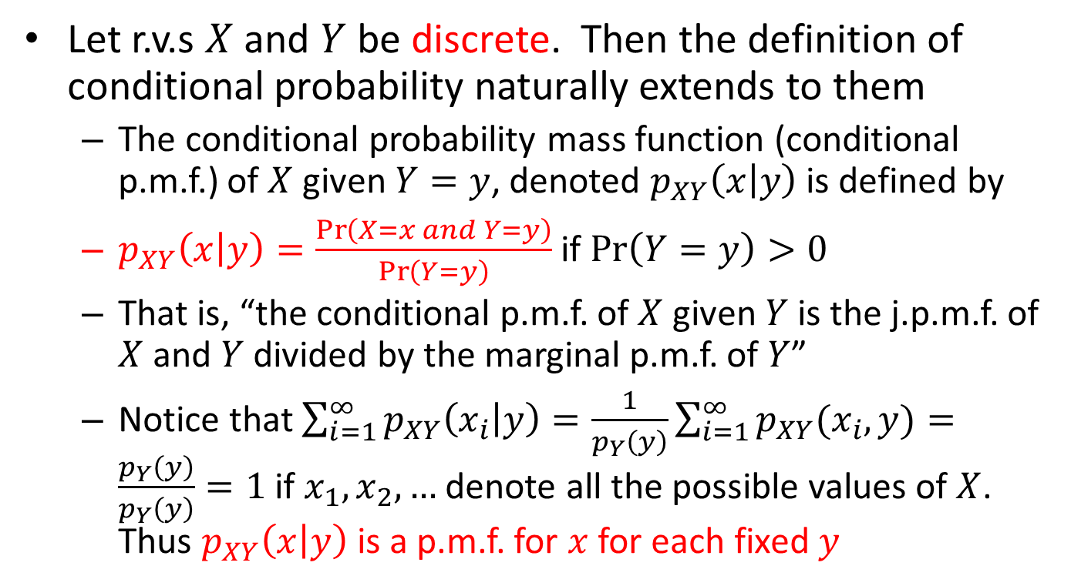
Conditional Probabilities and Expectations
Let r.v.s $X$ and $Y$ be discrete. Then the definition of conditional probability naturally extends to them
The conditional probability mass function (conditional p.m.f.) of $X$ given $Y=y$, denoted $p_{XY}\left(x | y\right)$ is defined by
$p_{XY}\left(x | y\right)=\frac{\operatorname{Pr}\left(X=x and Y=y\right)}{\operatorname{Pr}\left(Y=y\right)}$ if $\operatorname{Pr}\left(Y=y\right)>0$
That is, “the conditional p.m.f. of $X$ given $Y$ is the j.p.m.f. of $X$ and $Y$ divided by the marginal p.m.f. of $Y$”
Notice that $\sum_{i=1}^{∞}{p_{XY}\left(x_{i} | y\right)}=\frac{1}{p_{Y}\left(y\right)}\sum_{i=1}^{∞}{p_{XY}(x_{i},y)}=\frac{p_{Y}\left(y\right)}{p_{Y}\left(y\right)}=1$ if $x_{1}, x_{2},…$ denote all the possible values of $X$. Thus $p_{XY}\left(x | y\right)$ is a p.m.f. for $x$ for each fixed $y$

Slide 6
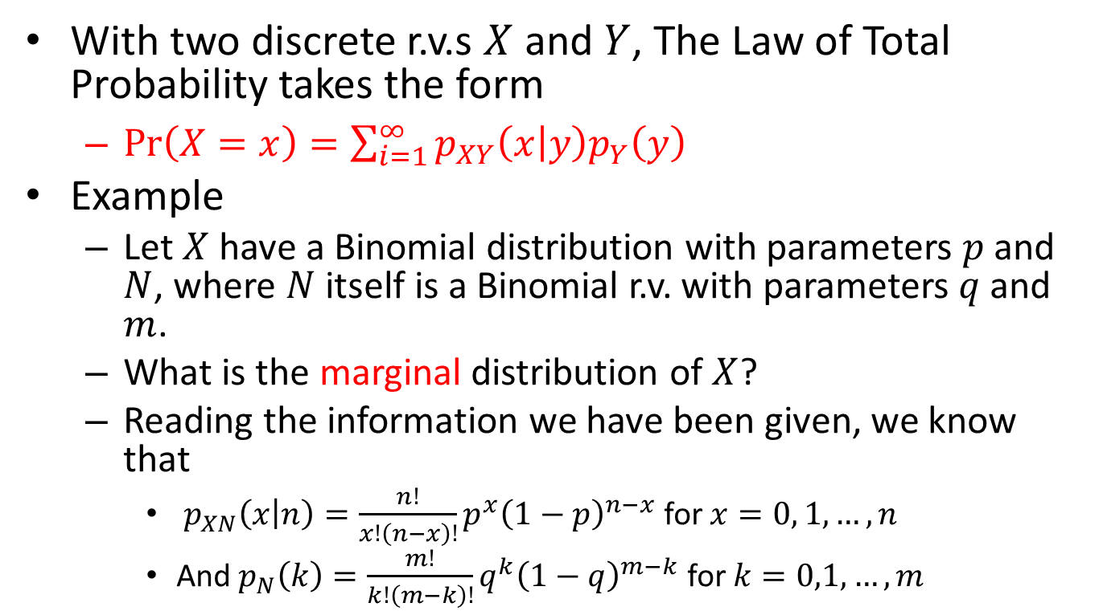
Conditional Probabilities and Expectations
With two discrete r.v.s $X$ and $Y$, The Law of Total Probability takes the form
$\operatorname{Pr}\left(X=x\right)=\sum_{i=1}^{∞}{p_{XY}\left(x | y\right)p_{Y}\left(y\right)}$
Example
Let $X$ have a Binomial distribution with parameters $p$ and $N$, where $N$ itself is a Binomial r.v. with parameters $q$ and $m$.
What is the marginal distribution of $X$?
Reading the information we have been given, we know that
$p_{XN}\left(x | n\right)=\frac{n!}{x!\left(n−x\right)!}p^{x}{\left(1−p\right)}^{n−x}$ for $x=0, 1, …,n$
And $p_{N}\left(k\right)=\frac{m!}{k!\left(m−k\right)!}q^{k}{\left(1−q\right)}^{m−k}$ for $k=0,1,…,m$

Slide 7
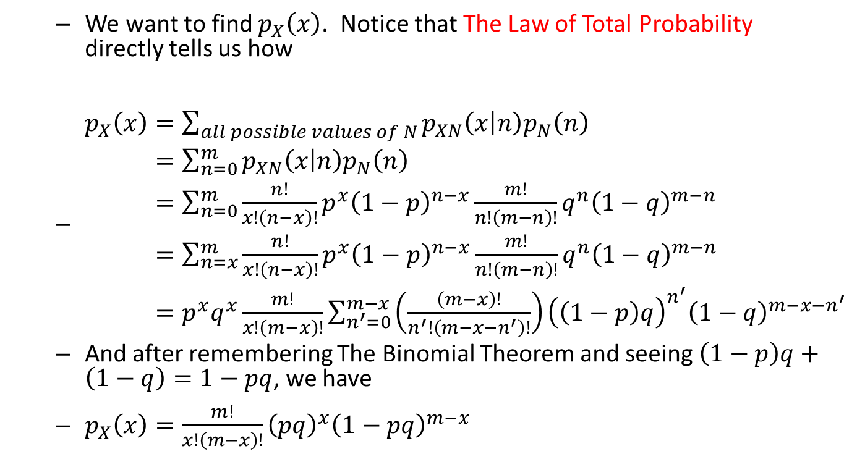
Conditional Probabilities and Expectations
We want to find $p_{X}\left(x\right)$. Notice that The Law of Total Probability directly tells us how
$\begin{aligned}p_{X}\left(x\right)&=\sum_{all possible values of N}{p_{XN}\left(x | n\right)p_{N}\left(n\right)} \\ &=\sum_{n=0}^{m}{p_{XN}\left(x | n\right)p_{N}\left(n\right)} \\ &=\sum_{n=0}^{m}{\frac{n!}{x!\left(n−x\right)!}p^{x}{\left(1−p\right)}^{n−x}\frac{m!}{n!\left(m−n\right)!}q^{n}{\left(1−q\right)}^{m−n}} \\ &=\sum_{n=x}^{m}{\frac{n!}{x!\left(n−x\right)!}p^{x}{\left(1−p\right)}^{n−x}\frac{m!}{n!\left(m−n\right)!}q^{n}{\left(1−q\right)}^{m−n}} \\ &=p^{x}q^{x}\frac{m!}{x!\left(m−x\right)!}\sum_{n^{′}=0}^{m−x}{\left(\frac{\left(m−x\right)!}{n^{′}!\left(m−x−n^{′}\right)!}\right){\left(\left(1−p\right)q\right)}^{n^{′}}{\left(1−q\right)}^{m−x−n^{′}}}\end{aligned}$
And after remembering The Binomial Theorem and seeing $\left(1−p\right)q+\left(1−q\right)=1−pq$, we have
$p_{X}\left(x\right)=\frac{m!}{x!\left(m−x\right)!}{\left(pq\right)}^{x}{\left(1−pq\right)}^{m−x}$

Slide 8
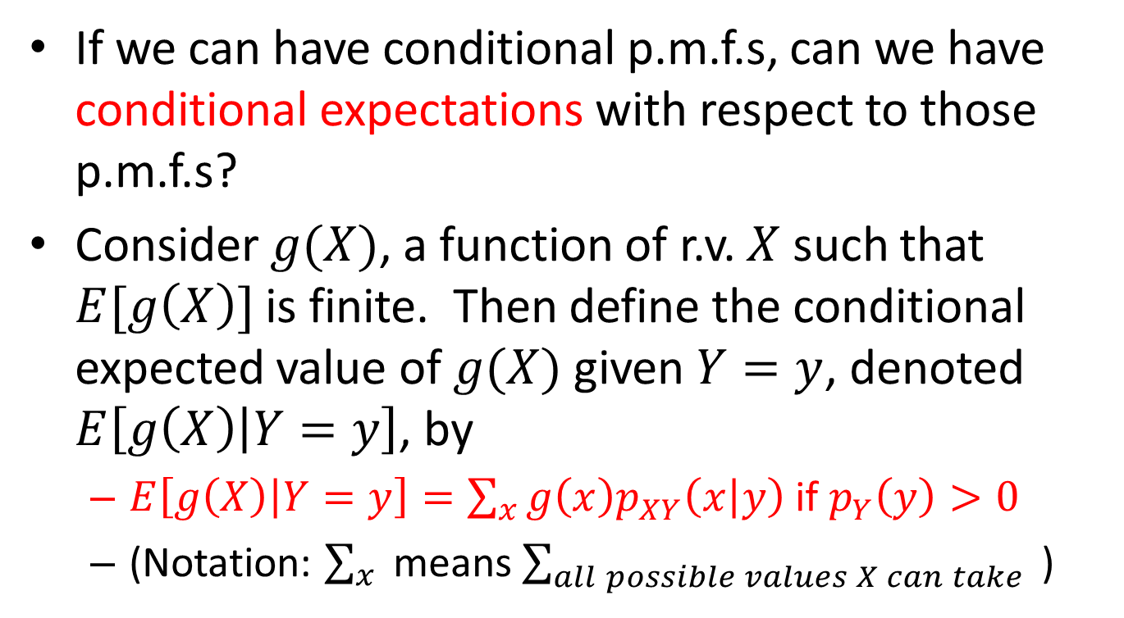
Conditional Probabilities and Expectations
If we can have conditional p.m.f.s, can we have conditional expectations with respect to those p.m.f.s?
Consider $g(X)$, a function of r.v. $X$ such that $E[g\left(X\right)]$ is finite. Then define the conditional expected value of $g(X)$ given $Y=y$, denoted $E\left[g\left(X\right) | Y=y\right]$, by
$E\left[g\left(X\right) | Y=y\right]=\sum_{x}{g\left(x\right)p_{XY}\left(x | y\right)}$ if $p_{Y}\left(y\right)>0$
(Notation: $\sum_{x}{ }$means $\sum_{all possible values X can take}{ }$)

Slide 9
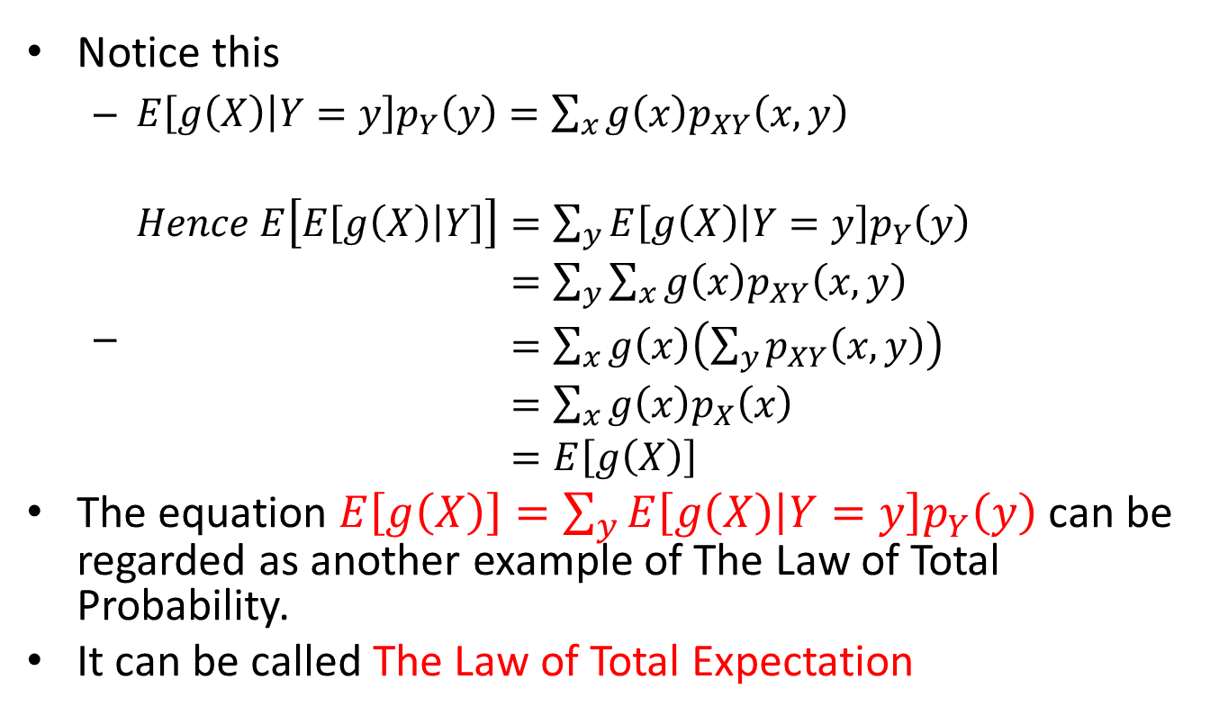
Conditional Probabilities and Expectations
Notice this
$E\left[g\left(X\right) | Y=y\right]p_{Y}\left(y\right)=\sum_{x}{g\left(x\right)p_{XY}\left(x,y\right)}$
$\begin{aligned}Hence E\left[E\left[g\left(X\right) | Y\right]\right]&=\sum_{y}{E\left[g\left(X\right) | Y=y\right]p_{Y}\left(y\right)} \\ &=\sum_{y}{\sum_{x}{g\left(x\right)p_{XY}\left(x,y\right)}} \\ &=\sum_{x}{g\left(x\right)\left(\sum_{y}{p_{XY}\left(x,y\right)}\right)} \\ &=\sum_{x}{g\left(x\right)p_{X}\left(x\right)} \\ &=E\left[g\left(X\right)\right]\end{aligned}$
The equation $E\left[g\left(X\right)\right]=\sum_{y}{E\left[g\left(X\right) | Y=y\right]p_{Y}\left(y\right)}$ can be regarded as another example of The Law of Total Probability.
It can be called The Law of Total Expectation

Slide 10
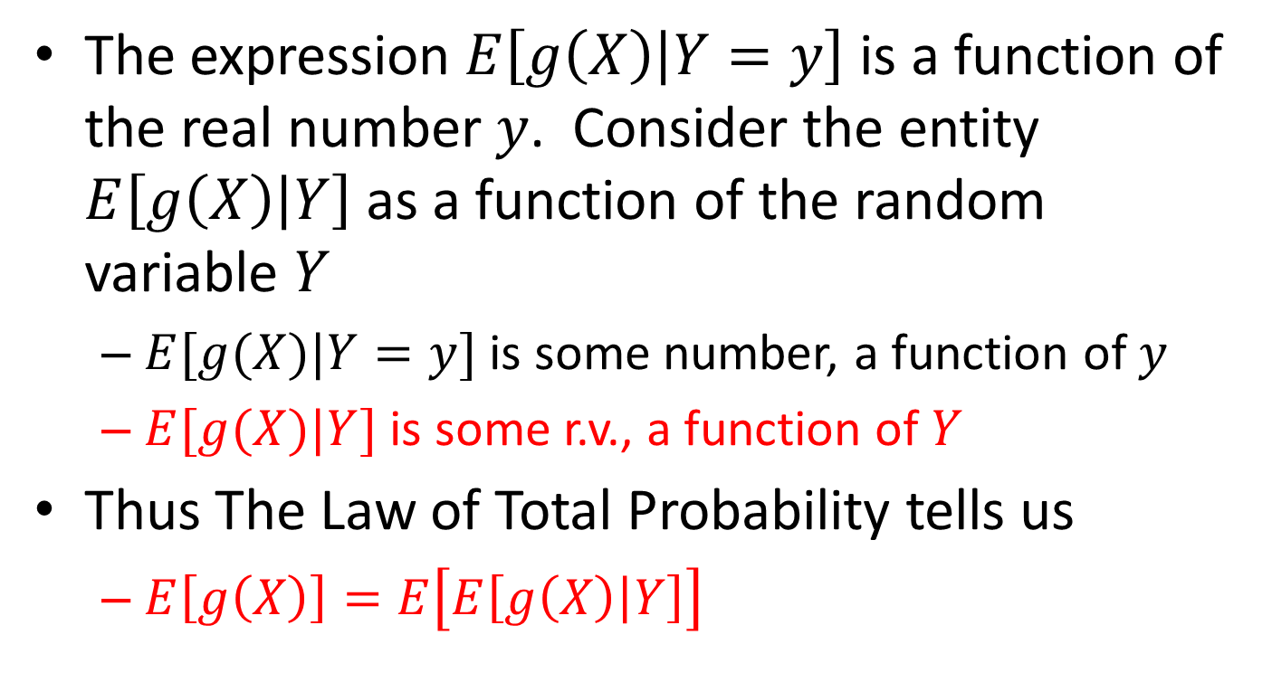
Conditional Probabilities and Expectations
The expression $E\left[g\left(X\right) | Y=y\right]$ is a function of the real number $y$. Consider the entity $E\left[g\left(X\right) | Y\right]$ as a function of the random variable $Y$
$E[g(X)|Y=y]$ is some number, a function of $y$
$E[g(X)|Y]$ is some r.v., a function of $Y$
Thus The Law of Total Probability tells us
$E\left[g\left(X\right)\right]=E\left[E\left[g\left(X\right) | Y\right]\right]$

Slide 11
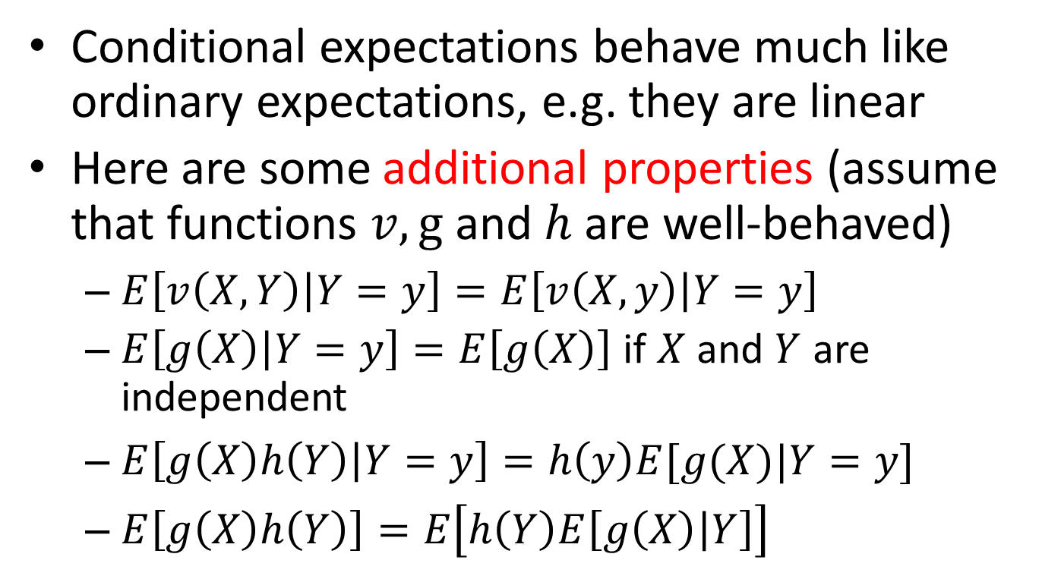
Conditional Probabilities and Expectations
Conditional expectations behave much like ordinary expectations, e.g. they are linear
Here are some additional properties (assume that functions $v, g$ and $h$ are well-behaved)
$E\left[v\left(X,Y\right) | Y=y\right]=E\left[v\left(X,y\right) | Y=y\right]$
$E\left[g\left(X\right) | Y=y\right]=E\left[g\left(X\right)\right]$ if $X$ and $Y$ are independent
$E\left[g\left(X\right)h\left(Y\right) | Y=y\right]=h\left(y\right)E[g(X)|Y=y]$
$E\left[g\left(X\right)h\left(Y\right)\right]=E\left[h\left(Y\right)E\left[g\left(X\right) | Y\right]\right]$

Slide 12
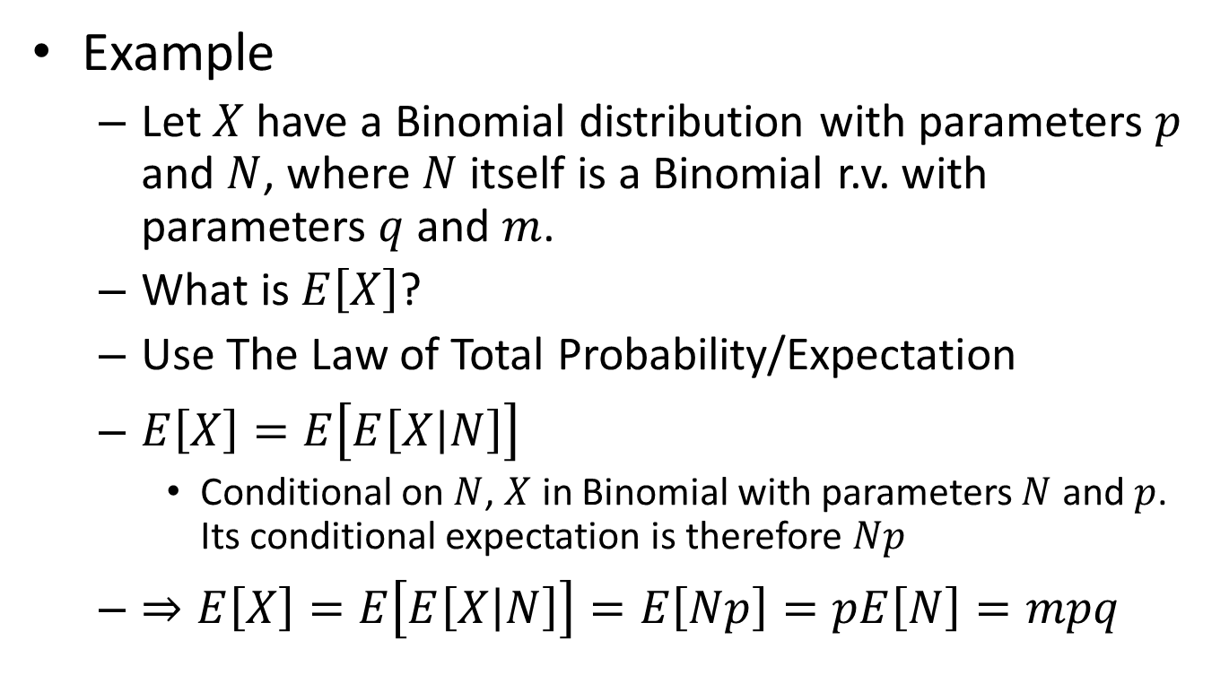
Conditional Probabilities and Expectations
Example
Let $X$ have a Binomial distribution with parameters $p$ and $N$, where $N$ itself is a Binomial r.v. with parameters $q$ and $m$.
What is $E\left[X\right]$?
Use The Law of Total Probability/Expectation
$E\left[X\right]=E\left[E\left[X | N\right]\right]$
Conditional on $N$, $X$ in Binomial with parameters $N$ and $p$. Its conditional expectation is therefore $Np$
$⇒E\left[X\right]=E\left[E\left[X | N\right]\right]=E\left[Np\right]=pE\left[N\right]=mpq$

Slide 13
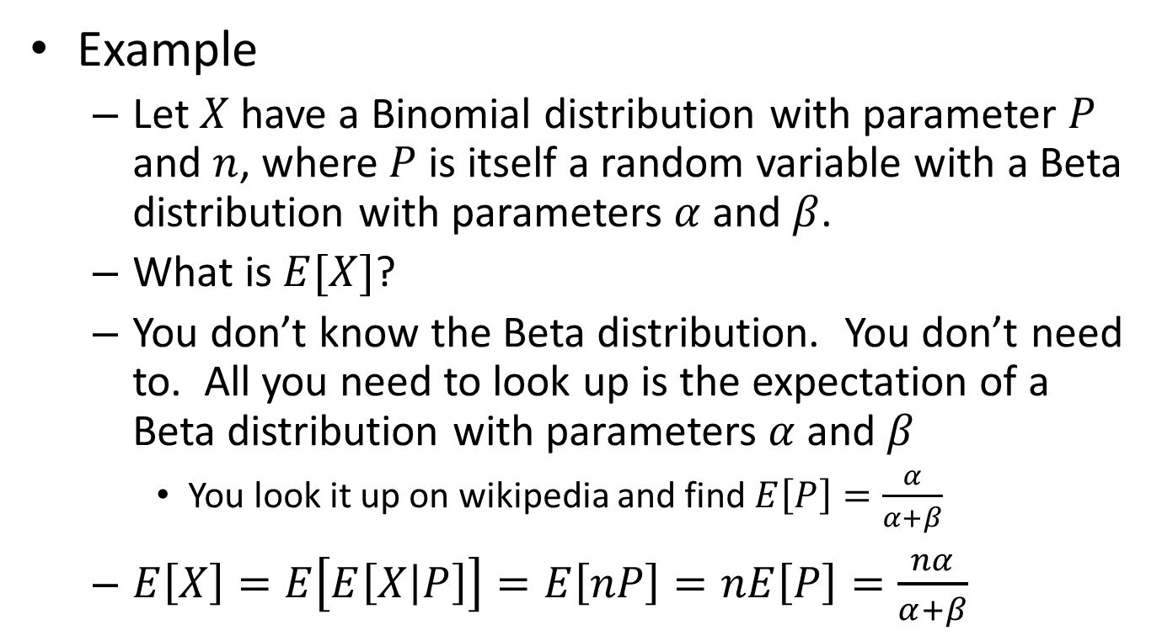
Conditional Probabilities and Expectations
Example
Let $X$ have a Binomial distribution with parameter $P$ and $n$, where $P$ is itself a random variable with a Beta distribution with parameters $α$ and $β$.
What is $E[X]$?
You don’t know the Beta distribution. You don’t need to. All you need to look up is the expectation of a Beta distribution with parameters $α$ and $β$
You look it up on wikipedia and find $E\left[P\right]=\frac{α}{α+β}$
$E\left[X\right]=E\left[E\left[X | P\right]\right]=E\left[nP\right]=nE\left[P\right]=\frac{nα}{α+β}$

Slide 14
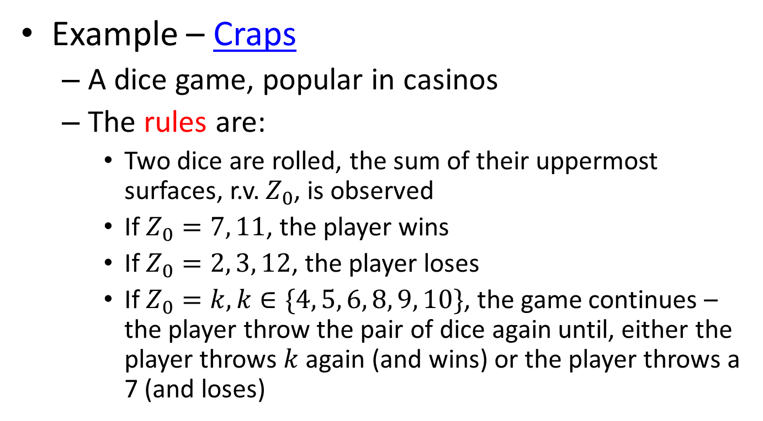
Conditional Probabilities and Expectations
Example – Craps
A dice game, popular in casinos
The rules are:
Two dice are rolled, the sum of their uppermost surfaces, r.v. $Z_{0}$, is observed
If $Z_{0}=7, 11$, the player wins
If $Z_{0}=2, 3, 12$, the player loses
If $Z_{0}=k, k∈\{4, 5, 6, 8, 9, 10\}$, the game continues – the player throw the pair of dice again until, either the player throws $k$ again (and wins) or the player throws a 7 (and loses)

Slide 15
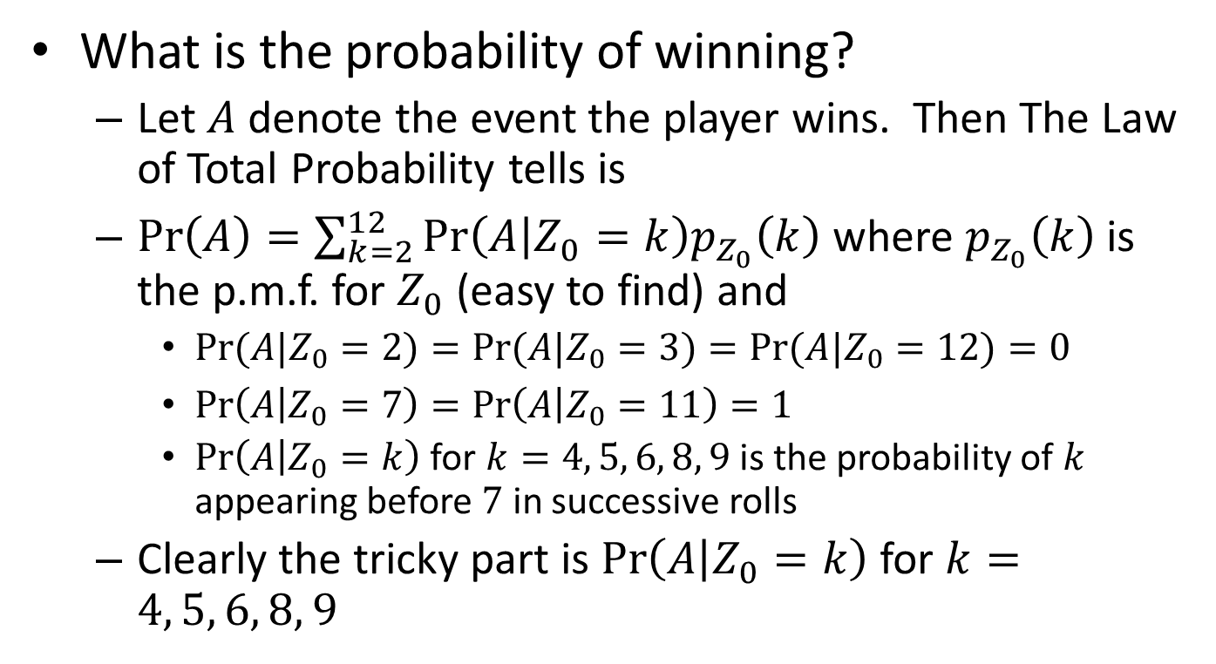
Conditional Probabilities and Expectations
What is the probability of winning?
Let $A$ denote the event the player wins. Then The Law of Total Probability tells is
$\operatorname{Pr}\left(A\right)=\sum_{k=2}^{12}{\operatorname{Pr}\left(A | Z_{0}=k\right)p_{Z_{0}}\left(k\right)}$ where $p_{Z_{0}}\left(k\right)$ is the p.m.f. for $Z_{0}$ (easy to find) and
$\operatorname{Pr}{(A|Z_{0}=2)}=\operatorname{Pr}{(A|Z_{0}=3)}=\operatorname{Pr}{(A|Z_{0}=12)}=0$
$\operatorname{Pr}\left(A | Z_{0}=7\right)=\operatorname{Pr}\left(A | Z_{0}=11\right)=1$
$\operatorname{Pr}\left(A | Z_{0}=k\right)$for $k=4, 5, 6, 8, 9$ is the probability of $k$ appearing before $7$ in successive rolls
Clearly the tricky part is $\operatorname{Pr}\left(A | Z_{0}=k\right)$ for $k=4, 5, 6, 8, 9$

Slide 16
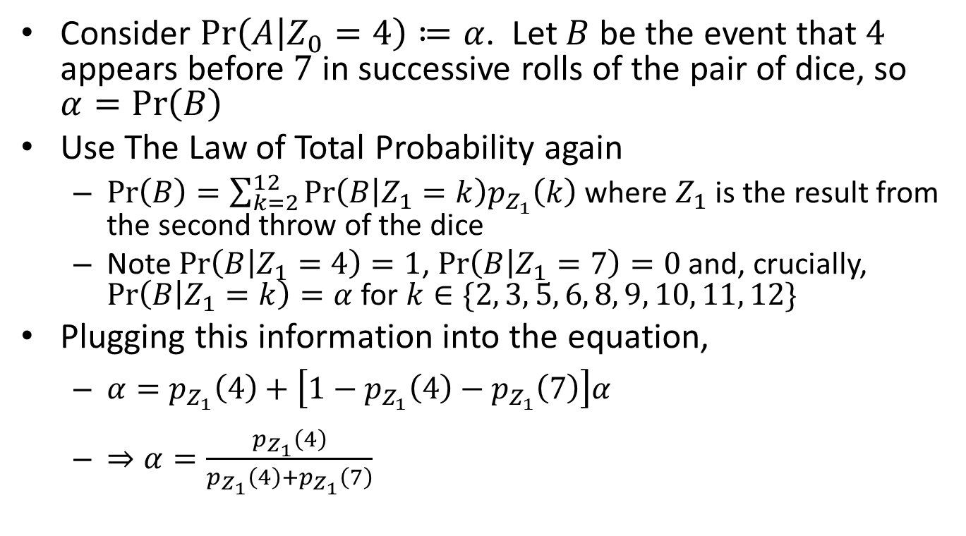
Conditional Probabilities and Expectations
Consider $\operatorname{Pr}\left(A | Z_{0}=4\right)≔α$. Let $B$ be the event that $4$ appears before $7$ in successive rolls of the pair of dice, so $α=\operatorname{Pr}\left(B\right)$
Use The Law of Total Probability again
$\operatorname{Pr}\left(B\right)=\sum_{k=2}^{12}{\operatorname{Pr}\left(B | Z_{1}=k\right)p_{Z_{1}}\left(k\right)}$ where $Z_{1}$ is the result from the second throw of the dice
Note $\operatorname{Pr}\left(B | Z_{1}=4\right)=1$, $\operatorname{Pr}\left(B | Z_{1}=7\right)=0$ and, crucially, $\operatorname{Pr}\left(B | Z_{1}=k\right)=α$ for $k∈\{2, 3, 5, 6, 8, 9, 10, 11, 12\}$
Plugging this information into the equation,
$α=p_{Z_{1}}\left(4\right)+\left[1−p_{Z_{1}}\left(4\right)−p_{Z_{1}}\left(7\right)\right]α$
$⇒α=\frac{p_{Z_{1}}\left(4\right)}{p_{Z_{1}}\left(4\right)+p_{Z_{1}}\left(7\right)}$

Slide 17
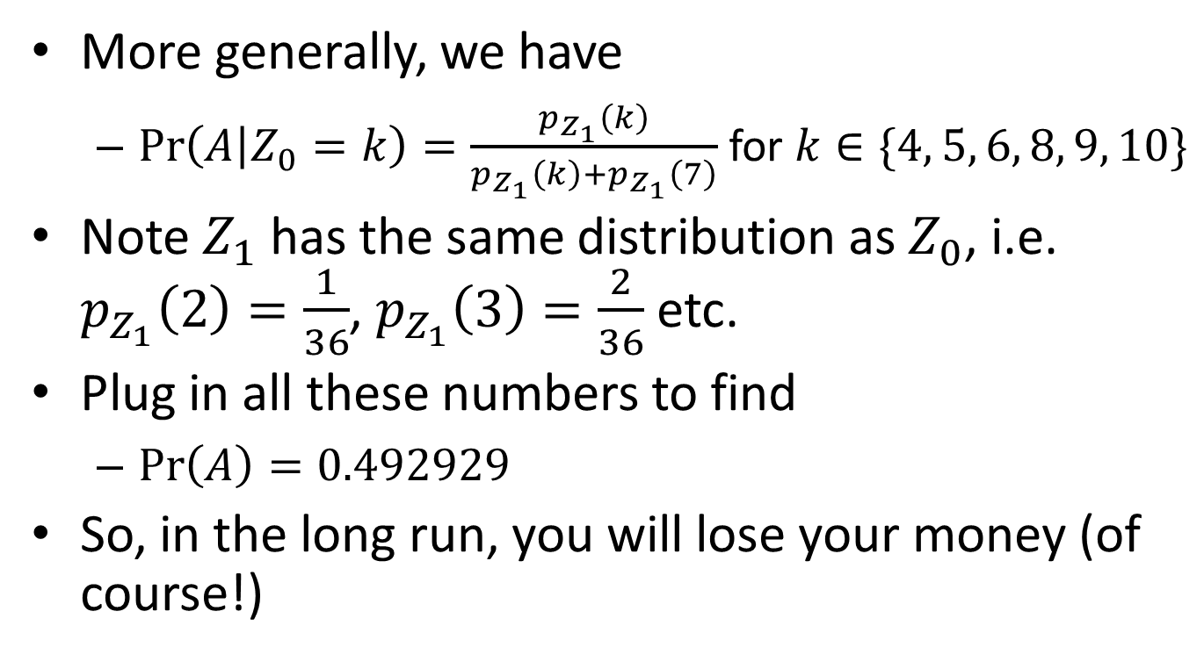
Conditional Probabilities and Expectations
More generally, we have
$\operatorname{Pr}\left(A | Z_{0}=k\right)=\frac{p_{Z_{1}}\left(k\right)}{p_{Z_{1}}\left(k\right)+p_{Z_{1}}\left(7\right)}$for $k∈\{4, 5, 6, 8, 9, 10\}$
Note $Z_{1}$ has the same distribution as $Z_{0}$, i.e. $p_{Z_{1}}\left(2\right)=\frac{1}{36}$, $p_{Z_{1}}\left(3\right)=\frac{2}{36}$ etc.
Plug in all these numbers to find
$\operatorname{Pr}\left(A\right)=0.492929$
So, in the long run, you will lose your money (of course!)

Slide 18
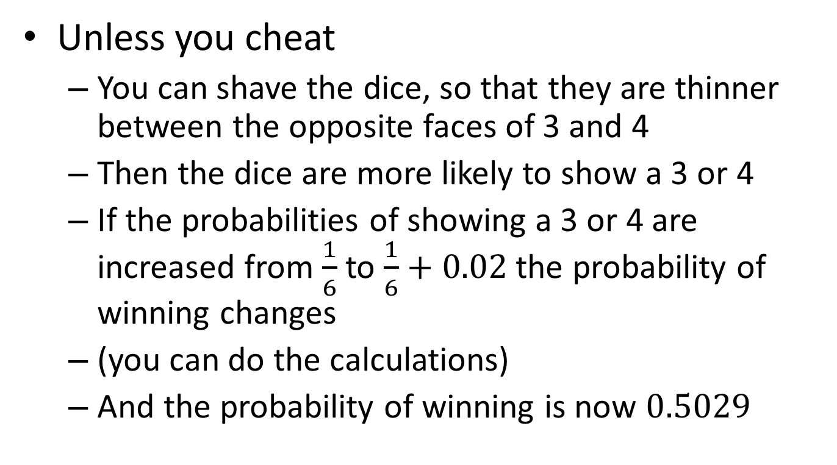
Conditional Probabilities and Expectations
Unless you cheat
You can shave the dice, so that they are thinner between the opposite faces of 3 and 4
Then the dice are more likely to show a 3 or 4
If the probabilities of showing a 3 or 4 are increased from $\frac{1}{6}$ to $\frac{1}{6}+0.02$ the probability of winning changes
(you can do the calculations)
And the probability of winning is now $0.5029$

Slide 19
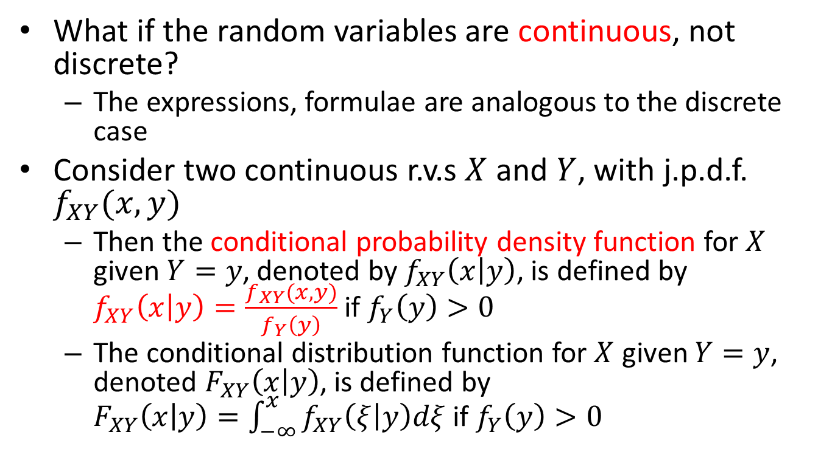
Conditional Probabilities and Expectations
What if the random variables are continuous, not discrete?
The expressions, formulae are analogous to the discrete case
Consider two continuous r.v.s $X$ and $Y$, with j.p.d.f. $f_{XY}(x,y)$
Then the conditional probability density function for $X$ given $Y=y$, denoted by $f_{XY}\left(x | y\right)$, is defined by $f_{XY}\left(x | y\right)=\frac{f_{XY}(x,y)}{f_{Y}\left(y\right)}$ if $f_{Y}\left(y\right)>0$
The conditional distribution function for $X$ given $Y=y$, denoted $F_{XY}\left(x | y\right)$, is defined by $F_{XY}\left(x | y\right)=\int_{−∞}^{x}{f_{XY}\left(ξ | y\right)dξ}$if $f_{Y}\left(y\right)>0$

Slide 20
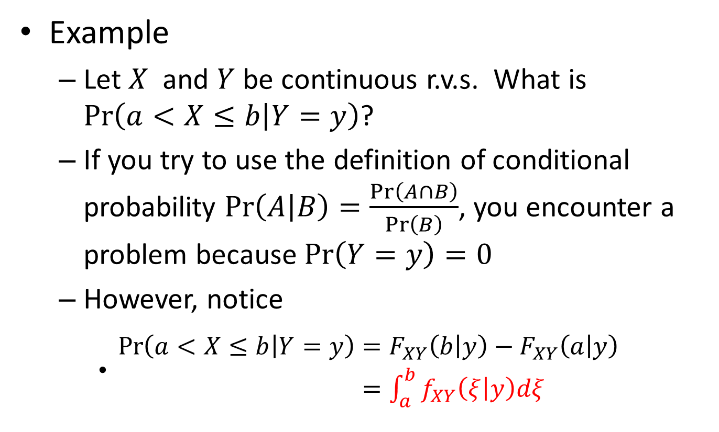
Conditional Probabilities and Expectations
Example
Let $X$ and $Y$ be continuous r.v.s. What is $\operatorname{Pr}\left(a<X≤b | Y=y\right)$?
If you try to use the definition of conditional probability $\operatorname{Pr}\left(A | B\right)=\frac{\operatorname{Pr}\left(A∩B\right)}{\operatorname{Pr}\left(B\right)}$, you encounter a problem because $\operatorname{Pr}\left(Y=y\right)=0$
However, notice
$\begin{aligned}\operatorname{Pr}\left(a<X≤b | Y=y\right)&=F_{XY}\left(b | y\right)−F_{XY}\left(a | y\right) \\ &=\int_{a}^{b}{f_{XY}\left(ξ | y\right)dξ}\end{aligned}$

Slide 21
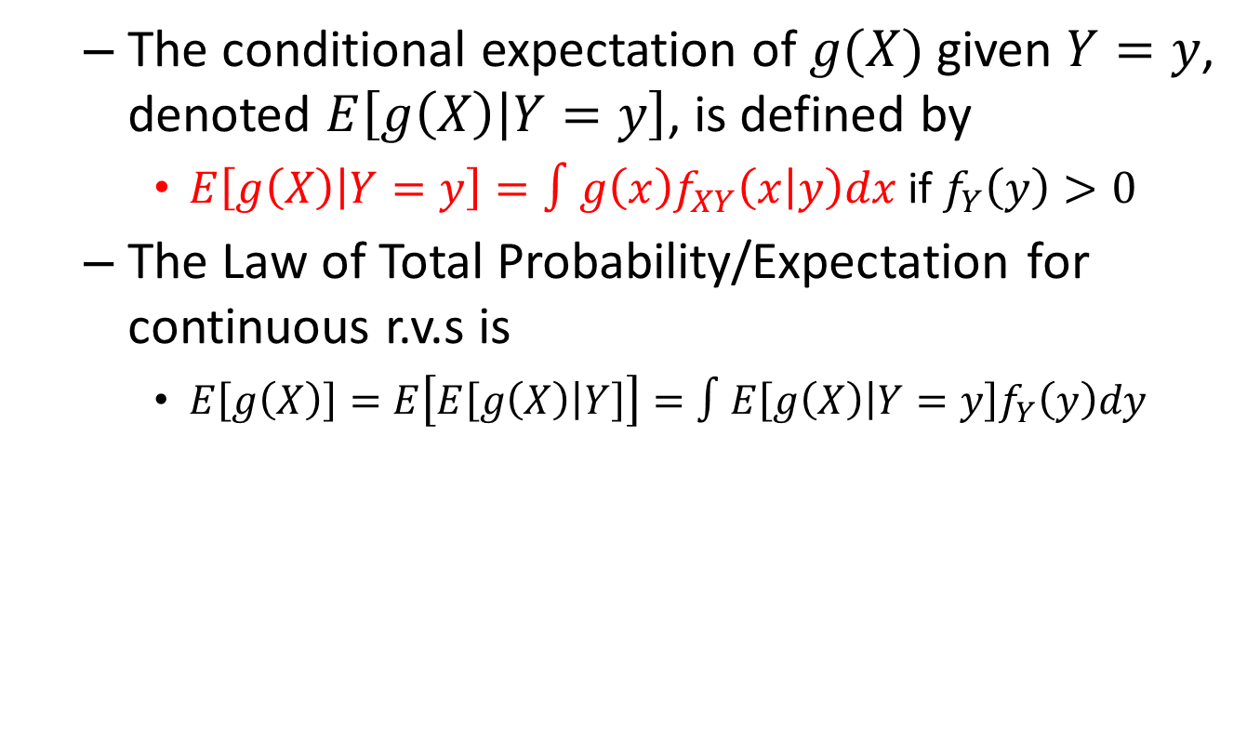
Conditional Probabilities and Expectations
The conditional expectation of $g(X)$ given $Y=y$, denoted $E\left[g\left(X\right) | Y=y\right]$, is defined by
$E\left[g\left(X\right) | Y=y\right]=∫g\left(x\right)f_{XY}\left(x | y\right)dx$ if $f_{Y}\left(y\right)>0$
The Law of Total Probability/Expectation for continuous r.v.s is
$E\left[g\left(X\right)\right]=E\left[E\left[g\left(X\right) | Y\right]\right]=∫E\left[g\left(X\right) | Y=y\right]f_{Y}\left(y\right)dy$

Slide 22
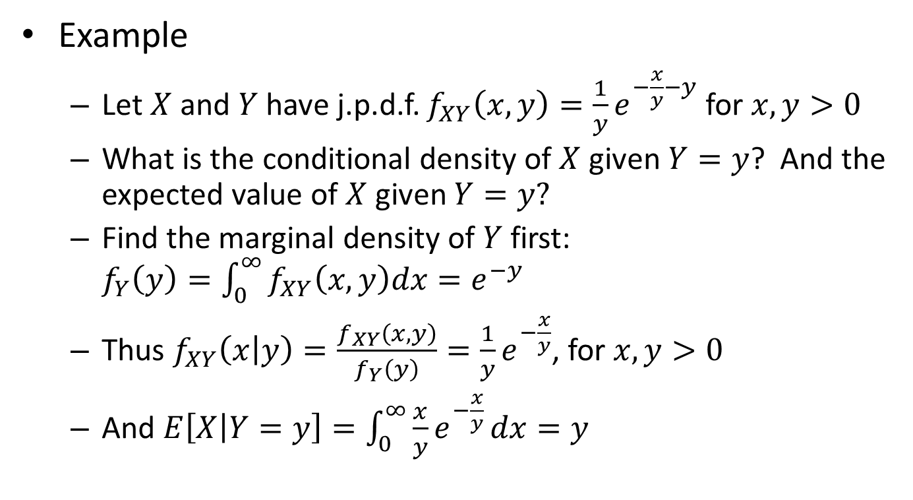
Conditional Probabilities and Expectations
Example
Let $X$ and $Y$ have j.p.d.f. $f_{XY}\left(x,y\right)=\frac{1}{y}e^{−\frac{x}{y}−y}$ for $x,y>0$
What is the conditional density of $X$ given $Y=y$? And the expected value of $X$ given $Y=y?$
Find the marginal density of $Y$ first: $f_{Y}\left(y\right)=\int_{0}^{∞}{f_{XY}\left(x,y\right)dx}=e^{−y}$
Thus $f_{XY}\left(x | y\right)=\frac{f_{XY}\left(x,y\right)}{f_{Y}\left(y\right)}=\frac{1}{y}e^{−\frac{x}{y}}$, for $x,y>0$
And $E\left[X | Y=y\right]=\int_{0}^{∞}{\frac{x}{y}e^{−\frac{x}{y}}}dx=y$

Slide 23
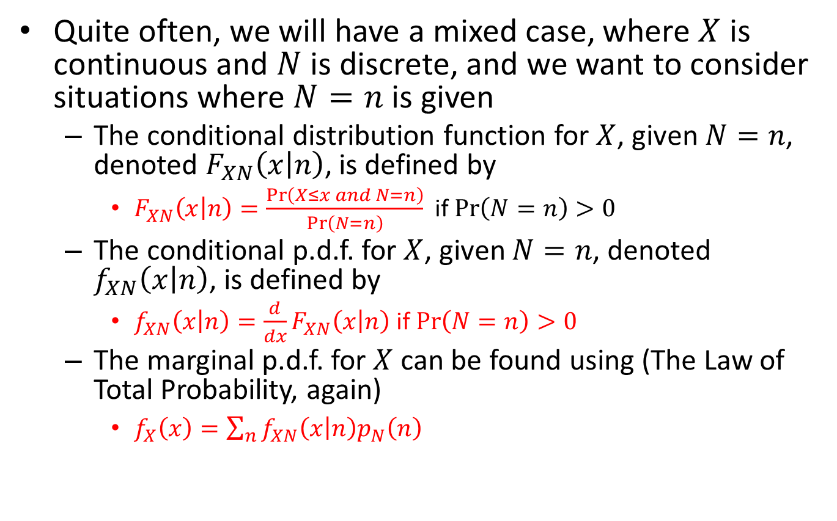
Conditional Probabilities and Expectations
Quite often, we will have a mixed case, where $X$ is continuous and $N$ is discrete, and we want to consider situations where $N=n$ is given
The conditional distribution function for $X$, given $N=n$, denoted $F_{XN}\left(x | n\right)$, is defined by
$F_{XN}\left(x | n\right)=\frac{\operatorname{Pr}\left(X≤x and N=n\right)}{\operatorname{Pr}\left(N=n\right)}$ if $\operatorname{Pr}\left(N=n\right)>0$
The conditional p.d.f. for $X$, given $N=n$, denoted $f_{XN}\left(x | n\right)$, is defined by
$f_{XN}\left(x | n\right)=\frac{d}{dx}F_{XN}\left(x | n\right)$ if $\operatorname{Pr}\left(N=n\right)>0$
The marginal p.d.f. for $X$ can be found using (The Law of Total Probability, again)
$f_{X}\left(x\right)=\sum_{n}{f_{XN}\left(x | n\right)p_{N}\left(n\right)}$

Slide 24
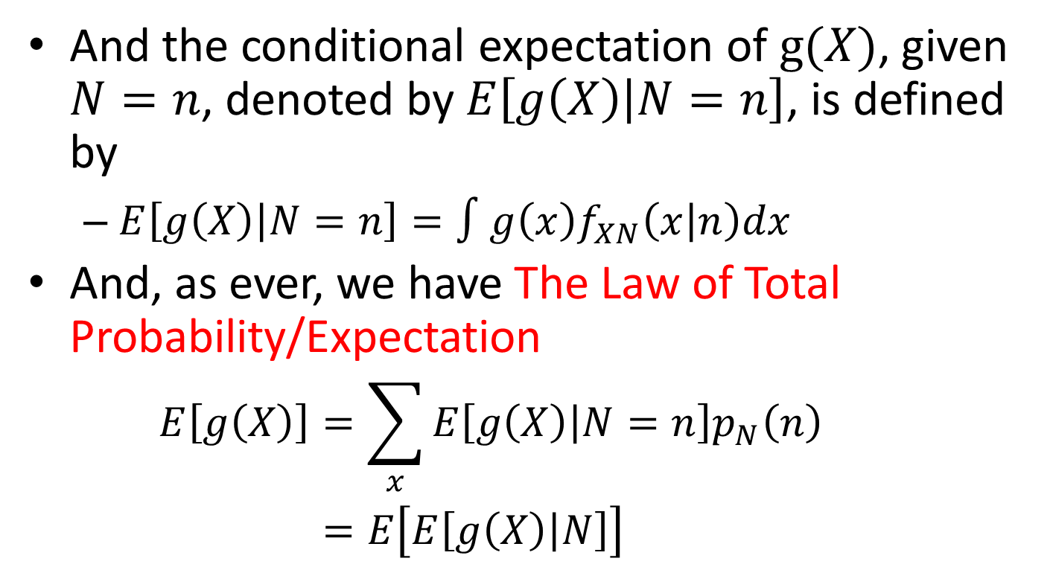
Conditional Probabilities and Expectations
And the conditional expectation of $g(X)$, given $N=n$, denoted by $E\left[g\left(X\right) | N=n\right]$, is defined by
$E\left[g\left(X\right) | N=n\right]=∫g\left(x\right)f_{XN}\left(x | n\right)dx$
And, as ever, we have The Law of Total Probability/Expectation
$$\begin{aligned}E\left[g\left(X\right)\right]&=\sum_{x}{E\left[g\left(X\right) | N=n\right]p_{N}\left(n\right)} \\ &=E\left[E\left[g\left(X\right) | N\right]\right]\end{aligned}$$

Slide 25
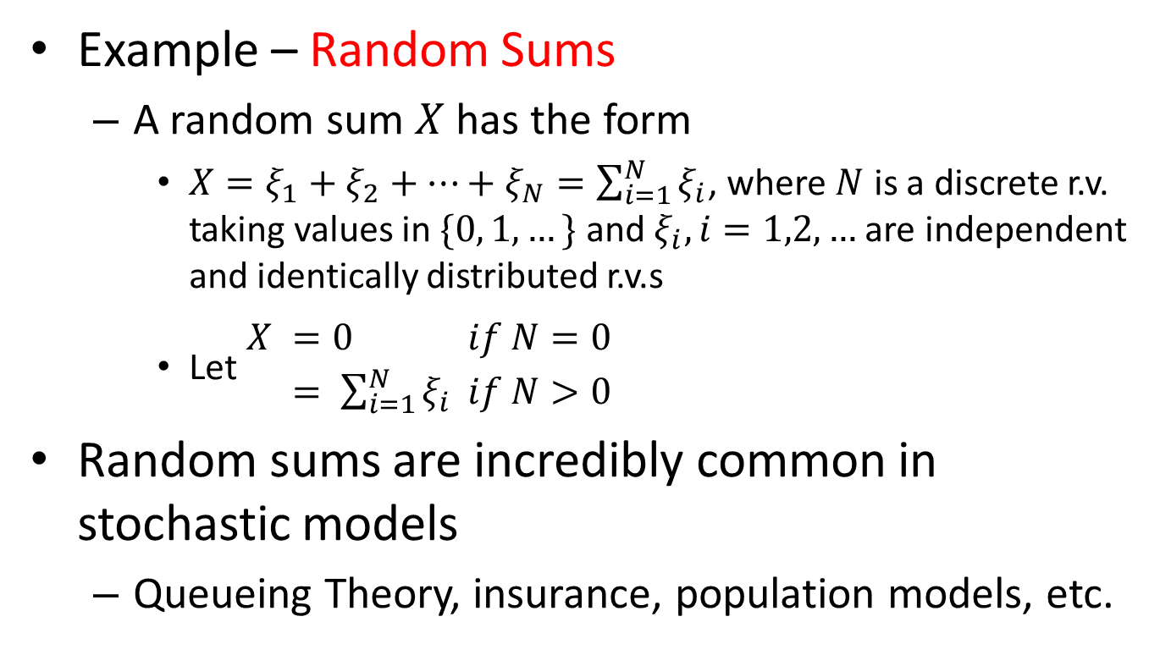
Conditional Probabilities and Expectations
Example – Random Sums
A random sum $X$ has the form
$X=ξ_{1}+ξ_{2}+…+ξ_{N}=\sum_{i=1}^{N}{ξ_{i}}$, where $N$ is a discrete r.v. taking values in $\{0, 1, …\}$ and $ξ_{i}, i=1,2,…$ are independent and identically distributed r.v.s
Let $\begin{aligned}X &=0 &if N=0 \\ &= \sum_{i=1}^{N}{ξ_{i}} &if N>0\end{aligned}$
Random sums are incredibly common in stochastic models
Queueing Theory, insurance, population models, etc.

Slide 26
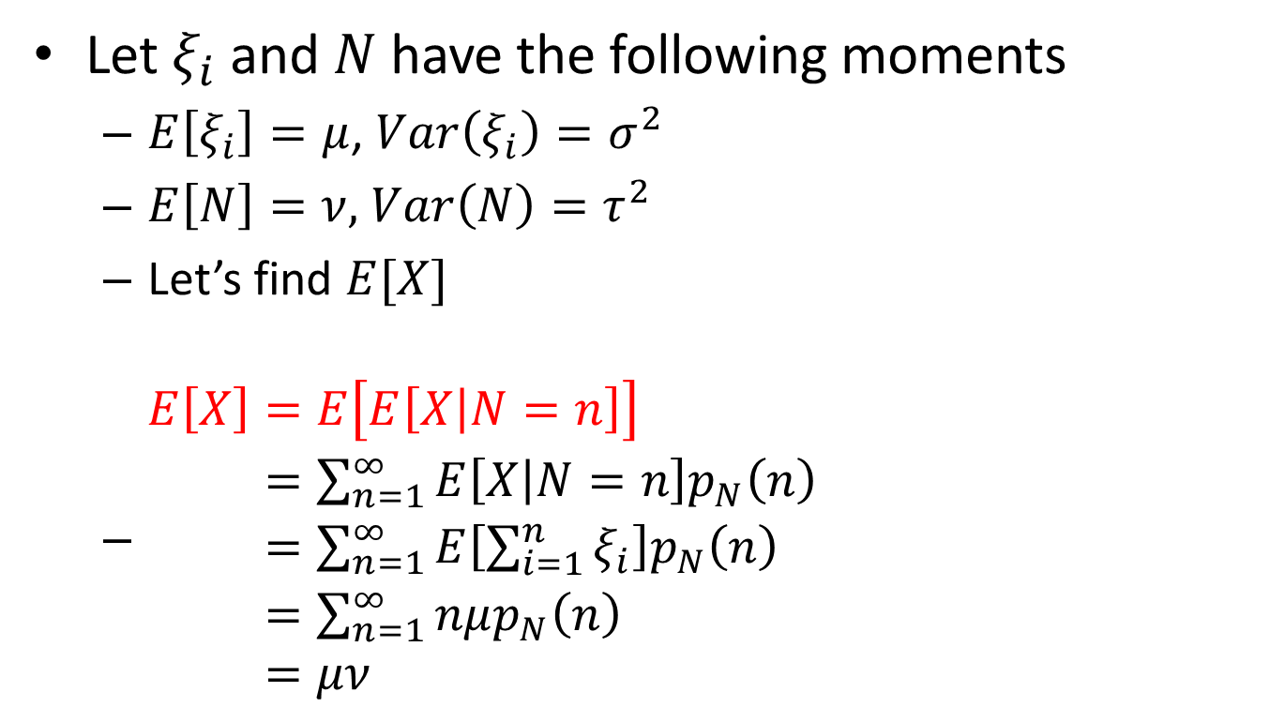
Conditional Probabilities and Expectations
Let $ξ_{i}$ and $N$ have the following moments
$E\left[ξ_{i}\right]=μ$, $Var\left(ξ_{i}\right)=σ^{2}$
$E\left[N\right]=ν,$ $Var\left(N\right)=τ^{2}$
Let’s find $E[X]$
$\begin{aligned}E\left[X\right]&=E\left[E\left[X | N=n\right]\right] \\ &=\sum_{n=1}^{∞}{E\left[X | N=n\right]p_{N}\left(n\right)} \\ &=\sum_{n=1}^{∞}{E\left[\sum_{i=1}^{n}{ξ_{i}}\right]p_{N}\left(n\right)} \\ &=\sum_{n=1}^{∞}{nμp_{N}\left(n\right)} \\ &=μν\end{aligned}$

Slide 27
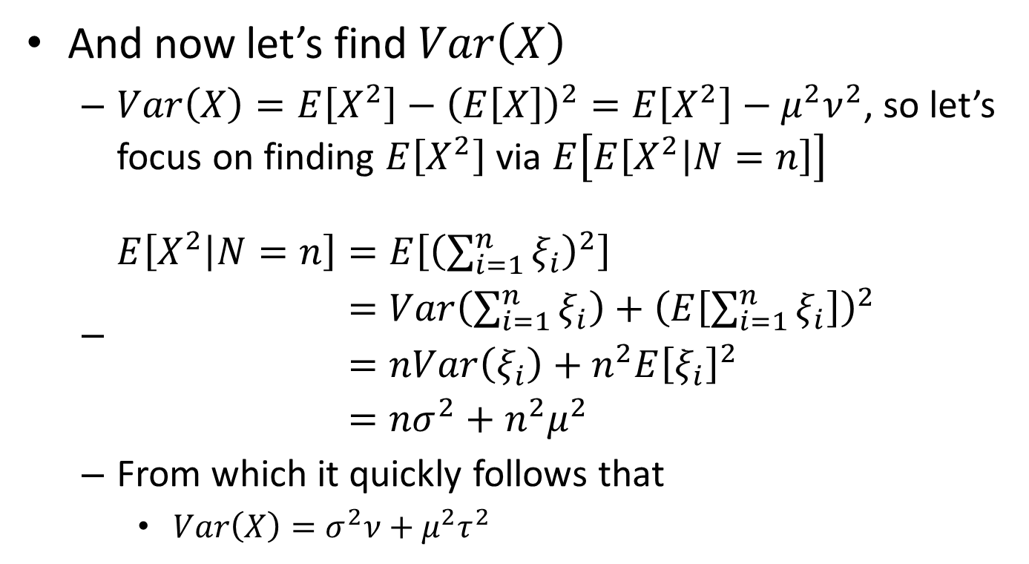
Conditional Probabilities and Expectations
And now let’s find $Var\left(X\right)$
$Var\left(X\right)=E\left[X^{2}\right]−{\left(E\left[X\right]\right)}^{2}=E\left[X^{2}\right]−μ^{2}ν^{2}$, so let’s focus on finding $E\left[X^{2}\right]$ via $E\left[E\left[X^{2} | N=n\right]\right]$
$\begin{aligned}E\left[X^{2} | N=n\right]&=E\left[{\left(\sum_{i=1}^{n}{ξ_{i}}\right)}^{2}\right] \\ &=Var\left(\sum_{i=1}^{n}{ξ_{i}}\right)+{\left(E\left[\sum_{i=1}^{n}{ξ_{i}}\right]\right)}^{2} \\ &=nVar\left(ξ_{i}\right)+n^{2}E{\left[ξ_{i}\right]}^{2} \\ &={nσ}^{2}+n^{2}μ^{2}\end{aligned}$
From which it quickly follows that
$Var\left(X\right)=σ^{2}ν+μ^{2}τ^{2}$

Slide 28
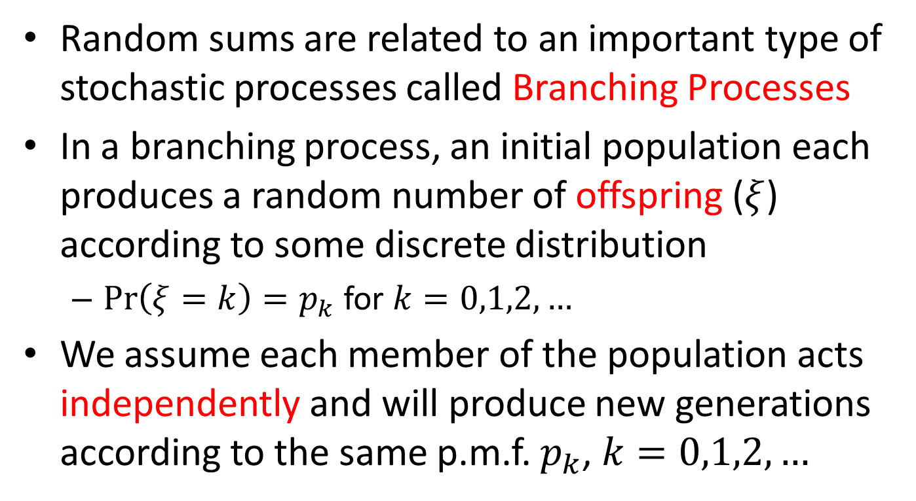
Conditional Probabilities and Expectations
Random sums are related to an important type of stochastic processes called Branching Processes
In a branching process, an initial population each produces a random number of offspring ($ξ$) according to some discrete distribution
$\operatorname{Pr}\left(ξ=k\right)=p_{k}$ for $k=0,1,2,…$
We assume each member of the population acts independently and will produce new generations according to the same p.m.f. $p_{k}$, $k=0,1,2,…$

Slide 29
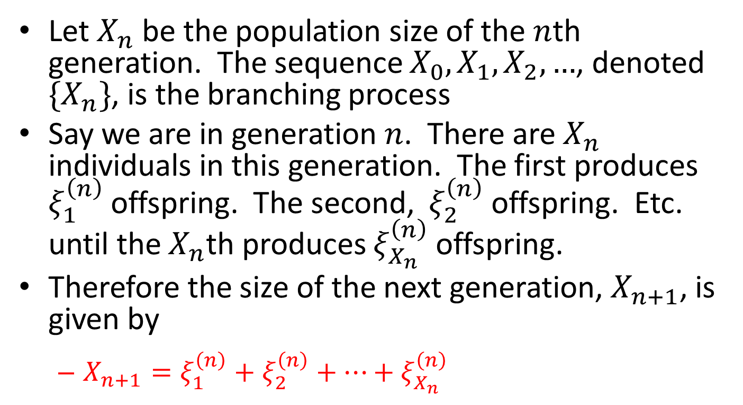
Conditional Probabilities and Expectations
Let $X_{n}$ be the population size of the $n$th generation. The sequence $X_{0},X_{1},X_{2},…$, denoted $\{X_{n}\}$, is the branching process
Say we are in generation $n$. There are $X_{n}$ individuals in this generation. The first produces $ξ_{1}^{\left(n\right)}$ offspring. The second, $ξ_{2}^{\left(n\right)}$offspring. Etc. until the $X_{n}$th produces $ξ_{X_{n}}^{\left(n\right)}$ offspring.
Therefore the size of the next generation, $X_{n+1}$, is given by
$X_{n+1}=ξ_{1}^{\left(n\right)}+ξ_{2}^{\left(n\right)}+…+ξ_{X_{n}}^{\left(n\right)}$

Slide 30
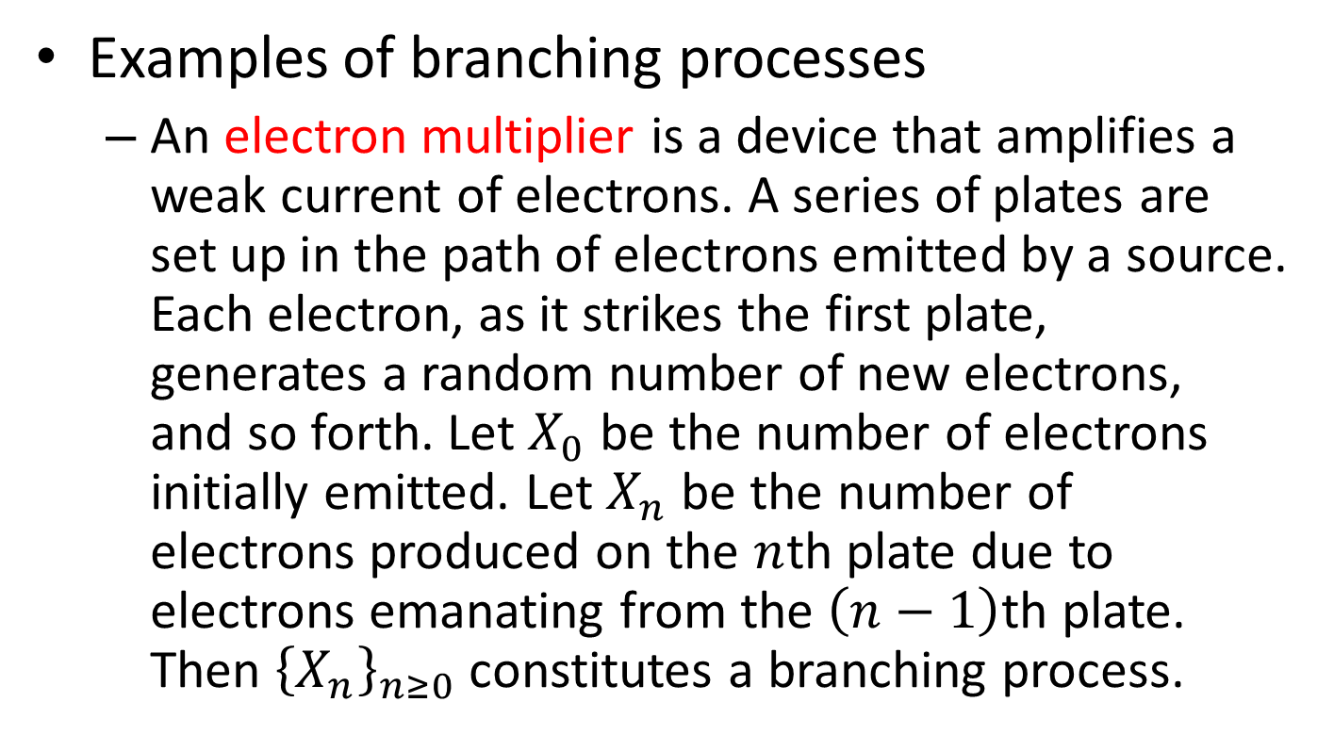
Conditional Probabilities and Expectations
Examples of branching processes
An electron multiplier is a device that amplifies a weak current of electrons. A series of plates are set up in the path of electrons emitted by a source. Each electron, as it strikes the first plate, generates a random number of new electrons, and so forth. Let $X_{0}$ be the number of electrons initially emitted. Let $X_{n}$ be the number of electrons produced on the $n$th plate due to electrons emanating from the $\left(n−1\right)$th plate. Then ${\left\{X_{n}\right\}}_{n≥0}$ constitutes a branching process.

Slide 31
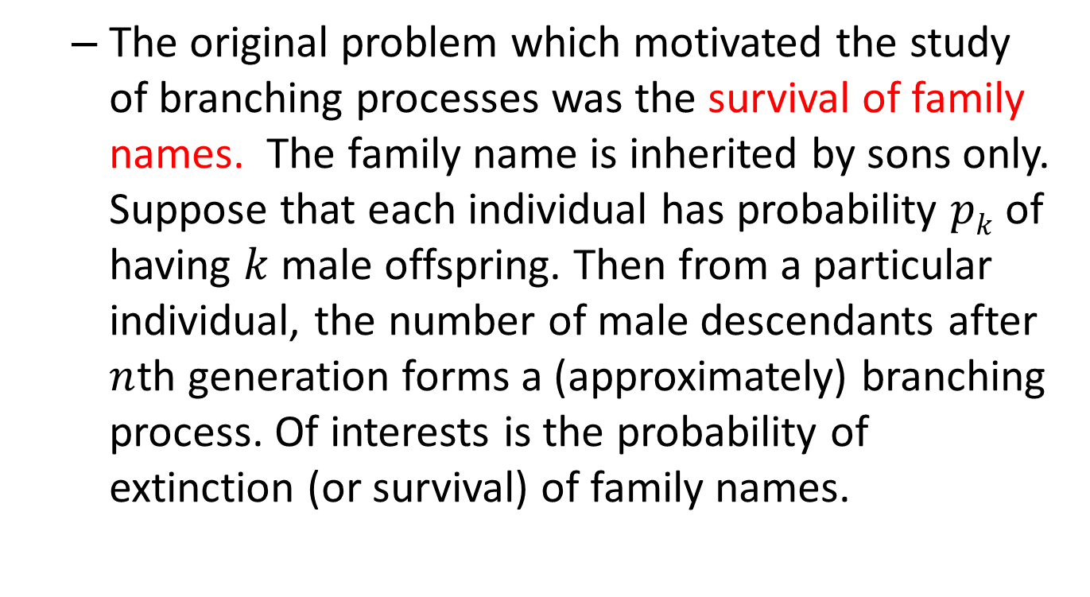
Conditional Probabilities and Expectations
The original problem which motivated the study of branching processes was the survival of family names. The family name is inherited by sons only. Suppose that each individual has probability $pk$ of having $k$ male offspring. Then from a particular individual, the number of male descendants after $n$th generation forms a (approximately) branching process. Of interests is the probability of extinction (or survival) of family names.

Slide 32
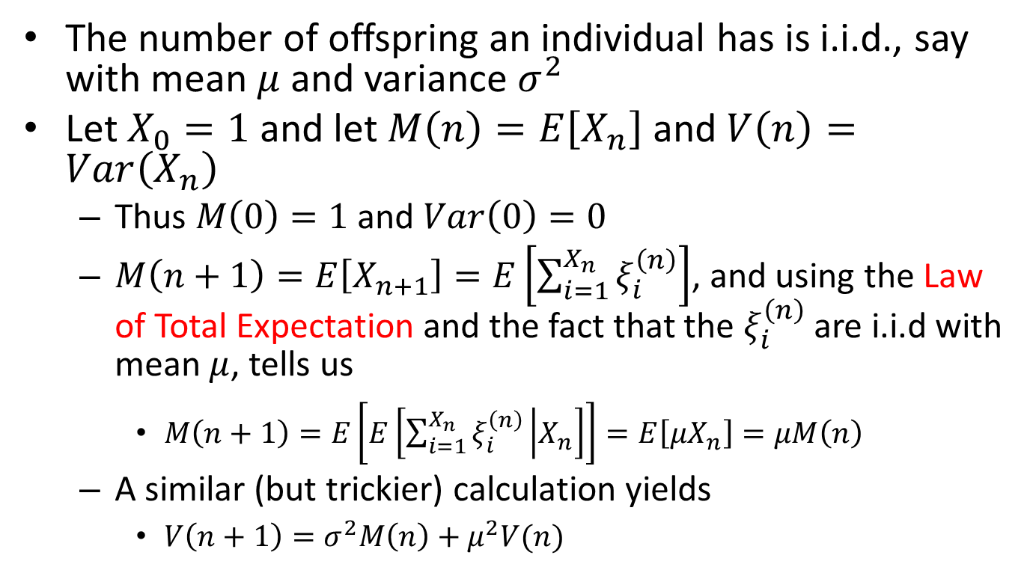
Conditional Probabilities and Expectations
The number of offspring an individual has is i.i.d., say with mean $μ$ and variance $σ^{2}$
Let $X_{0}=1$ and let $M\left(n\right)=E\left[X_{n}\right]$ and $V\left(n\right)=Var\left(X_{n}\right)$
Thus $M\left(0\right)=1$ and $Var\left(0\right)=0$
$M\left(n+1\right)=E\left[X_{n+1}\right]=E\left[\sum_{i=1}^{X_{n}}{ξ_{i}^{\left(n\right)}}\right]$, and using the Law of Total Expectation and the fact that the $ξ_{i}^{\left(n\right)}$ are i.i.d with mean $μ$, tells us
$M\left(n+1\right)=E\left[E\left[\sum_{i=1}^{X_{n}}{ξ_{i}^{\left(n\right)}} | X_{n}\right]\right]=E\left[μX_{n}\right]=μM\left(n\right)$
A similar (but trickier) calculation yields
$V\left(n+1\right)=σ^{2}M\left(n\right)+μ^{2}V(n)$

Slide 33
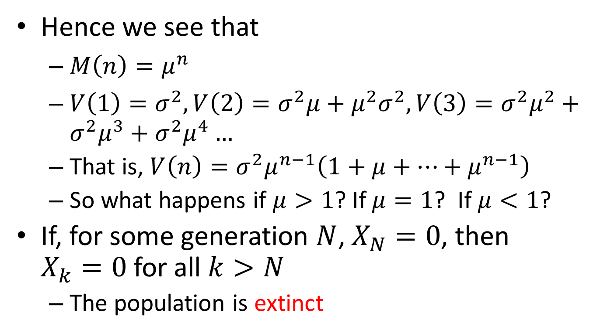
Conditional Probabilities and Expectations
Hence we see that
$M\left(n\right)=μ^{n}$
$V\left(1\right)=σ^{2}, V\left(2\right)=σ^{2}μ+μ^{2}σ^{2}, V\left(3\right)=σ^{2}μ^{2}+σ^{2}μ^{3}+σ^{2}μ^{4}…$
That is, $V\left(n\right)=σ^{2}μ^{n−1}\left(1+μ+…+μ^{n−1}\right)$
So what happens if $μ>1$? If $μ=1$? If $μ<1$?
If, for some generation $N$, $X_{N}=0$, then $X_{k}=0$ for all $k>N$
The population is extinct

Slide 34
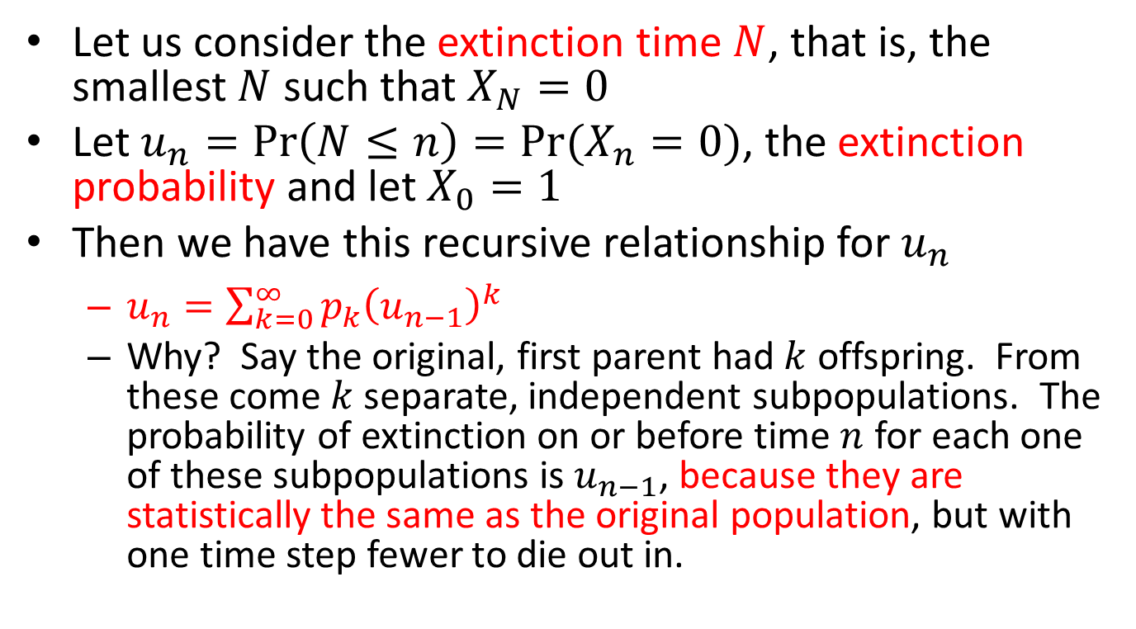
Conditional Probabilities and Expectations
Let us consider the extinction time $N$, that is, the smallest $N$ such that $X_{N}=0$
Let $u_{n}=\operatorname{Pr}\left(N≤n\right)=Pr⁡(X_{n}=0)$, the extinction probability and let $X_{0}=1$
Then we have this recursive relationship for $u_{n}$
$u_{n}=\sum_{k=0}^{∞}{p_{k}{\left(u_{n−1}\right)}^{k}}$
Why? Say the original, first parent had $k$ offspring. From these come $k$ separate, independent subpopulations. The probability of extinction on or before time $n$ for each one of these subpopulations is $u_{n−1}$, because they are statistically the same as the original population, but with one time step fewer to die out in.

Slide 35
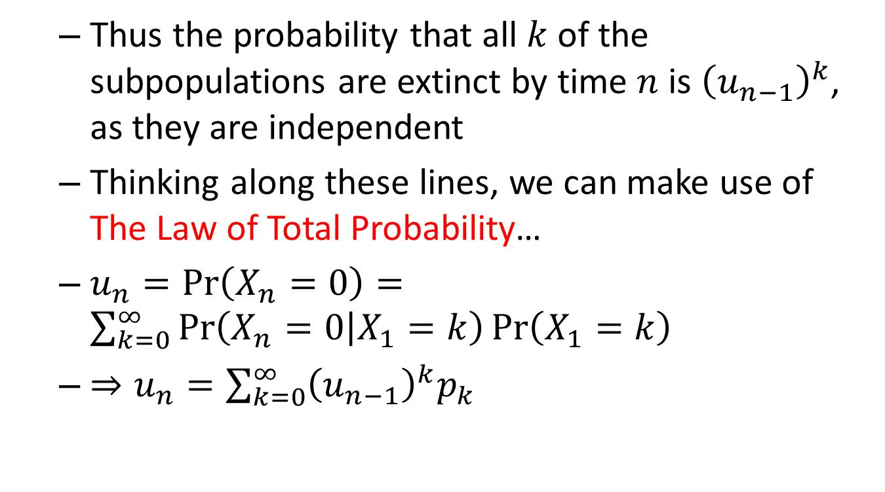
Conditional Probabilities and Expectations
Thus the probability that all $k$ of the subpopulations are extinct by time $n$ is ${\left(u_{n−1}\right)}^{k}$, as they are independent
Thinking along these lines, we can make use of The Law of Total Probability…
$u_{n}=\operatorname{Pr}\left(X_{n}=0\right)=\sum_{k=0}^{∞}{\operatorname{Pr}\left(X_{n}=0 | X_{1}=k\right)\operatorname{Pr}\left(X_{1}=k\right)}$
$⇒u_{n}=\sum_{k=0}^{∞}{{\left(u_{n−1}\right)}^{k}p_{k}}$

Slide 36
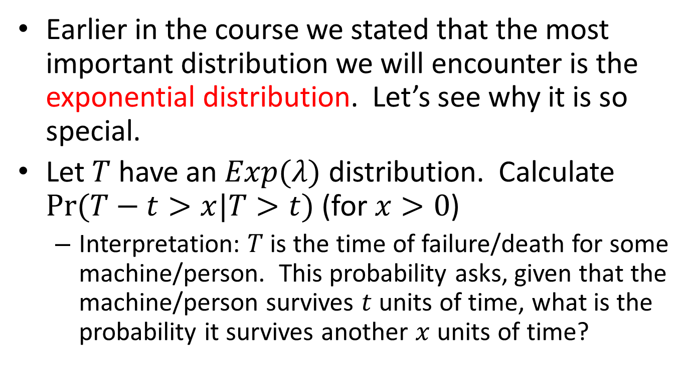
Conditional Probabilities and Expectations
Earlier in the course we stated that the most important distribution we will encounter is the exponential distribution. Let’s see why it is so special.
Let $T$ have an $Exp(λ)$ distribution. Calculate $Pr⁡(T−t>x|T>t)$ (for $x>0$)
Interpretation: $T$ is the time of failure/death for some machine/person. This probability asks, given that the machine/person survives $t$ units of time, what is the probability it survives another $x$ units of time?

Slide 37
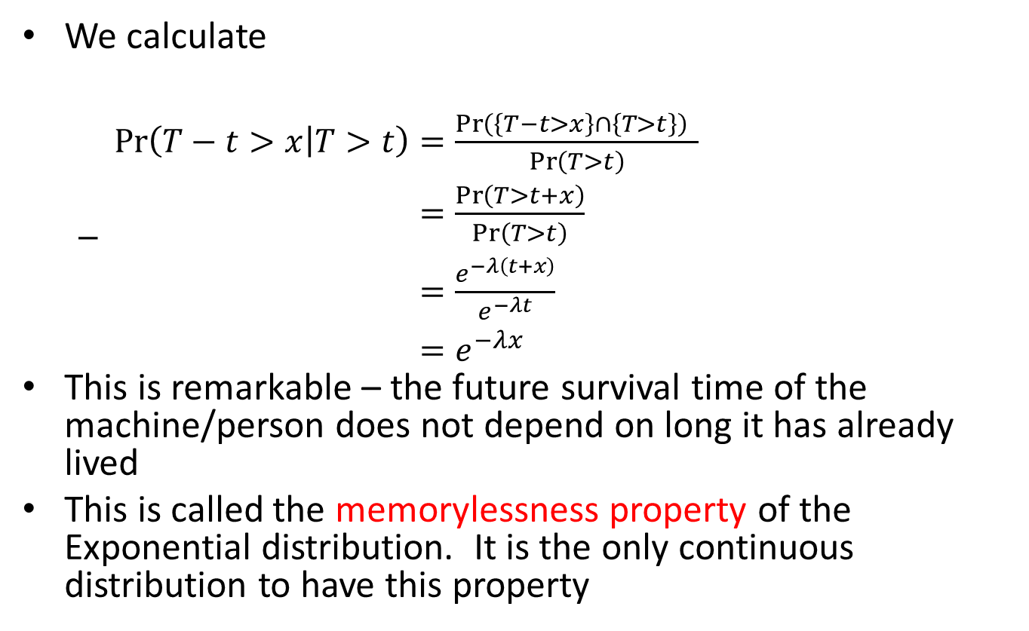
Conditional Probabilities and Expectations
We calculate
$\begin{aligned}\operatorname{Pr}\left(T−t>x | T>t\right)&=\frac{\operatorname{Pr}\left(\left\{T−t>x\right\}∩\left\{T>t\right\}\right) }{\operatorname{Pr}\left(T>t\right)} \\ &=\frac{\operatorname{Pr}\left(T>t+x\right)}{\operatorname{Pr}\left(T>t\right)} \\ &=\frac{e^{−λ\left(t+x\right)}}{e^{−λt}} \\ &=e^{−λx}\end{aligned}$
This is remarkable – the future survival time of the machine/person does not depend on long it has already lived
This is called the memorylessness property of the Exponential distribution. It is the only continuous distribution to have this property

Slide 38
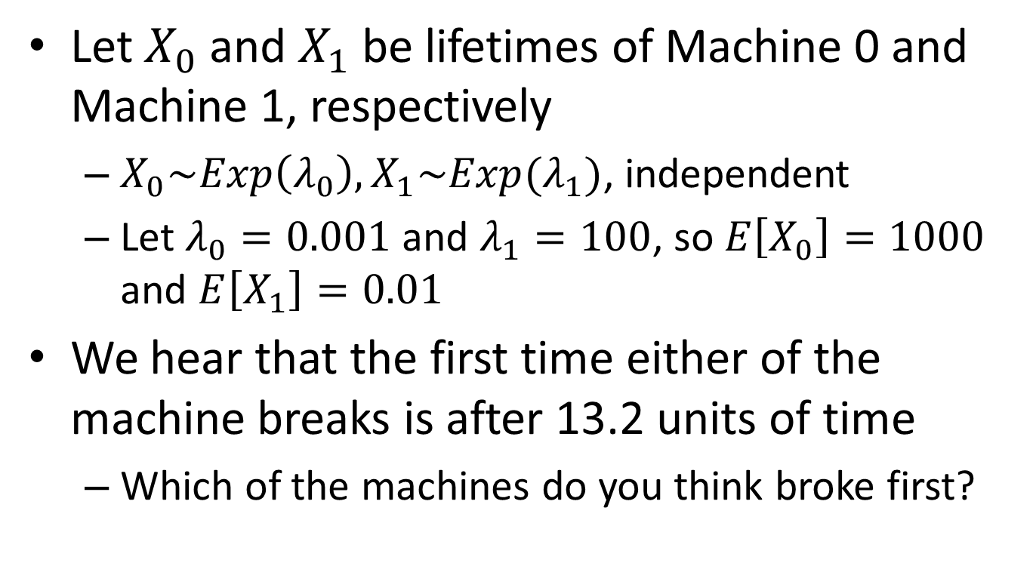
Conditional Probabilities and Expectations
Let $X_{0}$ and $X_{1}$ be lifetimes of Machine 0 and Machine 1, respectively
$X_{0}\sim Exp\left(λ_{0}\right), X_{1}\sim Exp(λ_{1})$, independent
Let $λ_{0}=0.001$ and $λ_{1}=100$, so $E\left[X_{0}\right]=1000$ and $E\left[X_{1}\right]=0.01$
We hear that the first time either of the machine breaks is after 13.2 units of time
Which of the machines do you think broke first?

Slide 39
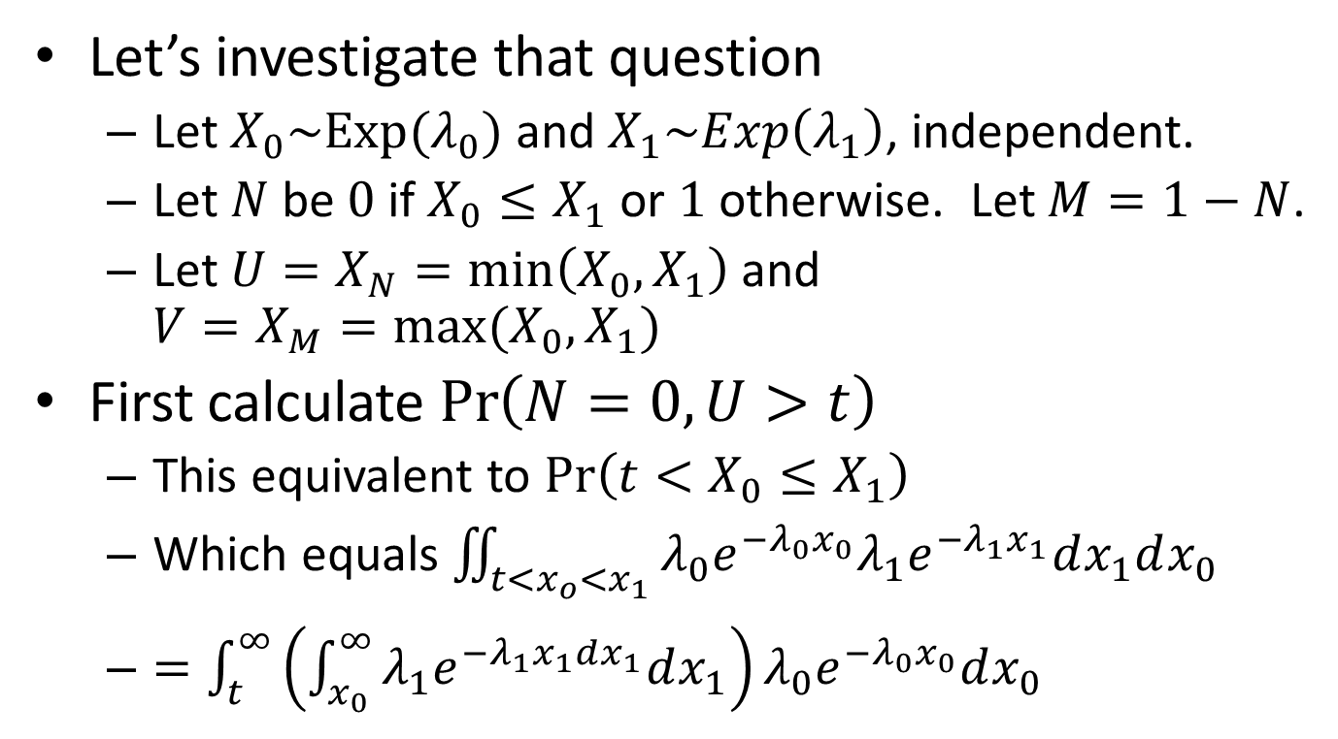
Conditional Probabilities and Expectations
Let’s investigate that question
Let $X_{0}\sim Exp(λ_{0})$ and $X_{1}\sim Exp\left(λ_{1}\right)$, independent.
Let $N$be $0$ if $X_{0}≤X_{1}$ or $1$ otherwise. Let $M=1−N$.
Let $U=X_{N}=\min\left(X_{0},X_{1}\right)$ and $V=X_{M}=\max{(X_{0},X_{1}})$
First calculate $\operatorname{Pr}\left(N=0,U>t\right)$
This equivalent to $\operatorname{Pr}\left(t<X_{0}≤X_{1}\right)$
Which equals $\iint_{t<x_{o}<x_{1}}^{ }{λ_{0}e^{−λ_{0}x_{0}}λ_{1}e^{−λ_{1}x_{1}}dx_{1}dx_{0}}$
$=\int_{t}^{∞}{\left(\int_{x_{0}}^{∞}{λ_{1}e^{−λ_{1}x_{1}dx_{1}}dx_{1}}\right)λ_{0}e^{−λ_{0}x_{0}}dx_{0}}$

Slide 40
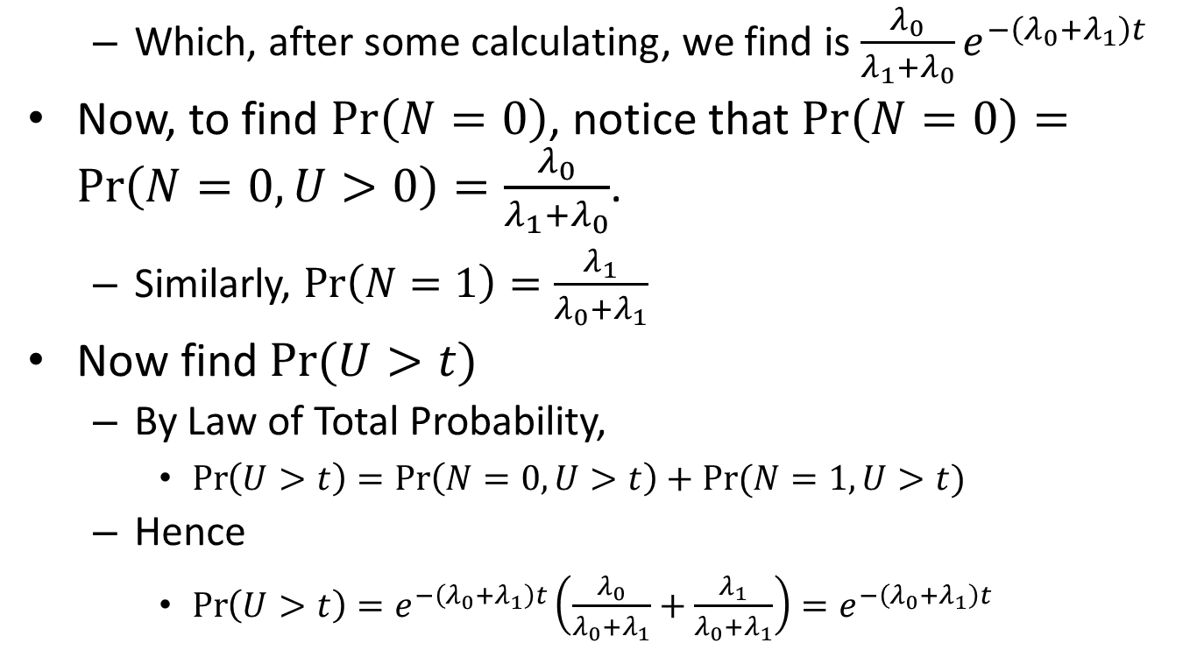
Conditional Probabilities and Expectations
Which, after some calculating, we find is $\frac{λ_{0}}{λ_{1}+λ_{0}}e^{−\left(λ_{0}+λ_{1}\right)t}$
Now, to find $\operatorname{Pr}\left(N=0\right)$, notice that $\operatorname{Pr}\left(N=0\right)=\operatorname{Pr}\left(N=0,U>0\right)=\frac{λ_{0}}{λ_{1}+λ_{0}}$.
Similarly, $\operatorname{Pr}\left(N=1\right)=\frac{λ_{1}}{λ_{0}+λ_{1}}$
Now find $Pr⁡(U>t)$
By Law of Total Probability,
$\operatorname{Pr}\left(U>t\right)=\operatorname{Pr}\left(N=0,U>t\right)+Pr⁡(N=1,U>t)$
Hence
$\operatorname{Pr}\left(U>t\right)=e^{−\left(λ_{0}+λ_{1}\right)t}\left(\frac{λ_{0}}{λ_{0}+λ_{1}}+\frac{λ_{1}}{λ_{0}+λ_{1}}\right)=e^{−\left(λ_{0}+λ_{1}\right)t}$

Slide 41
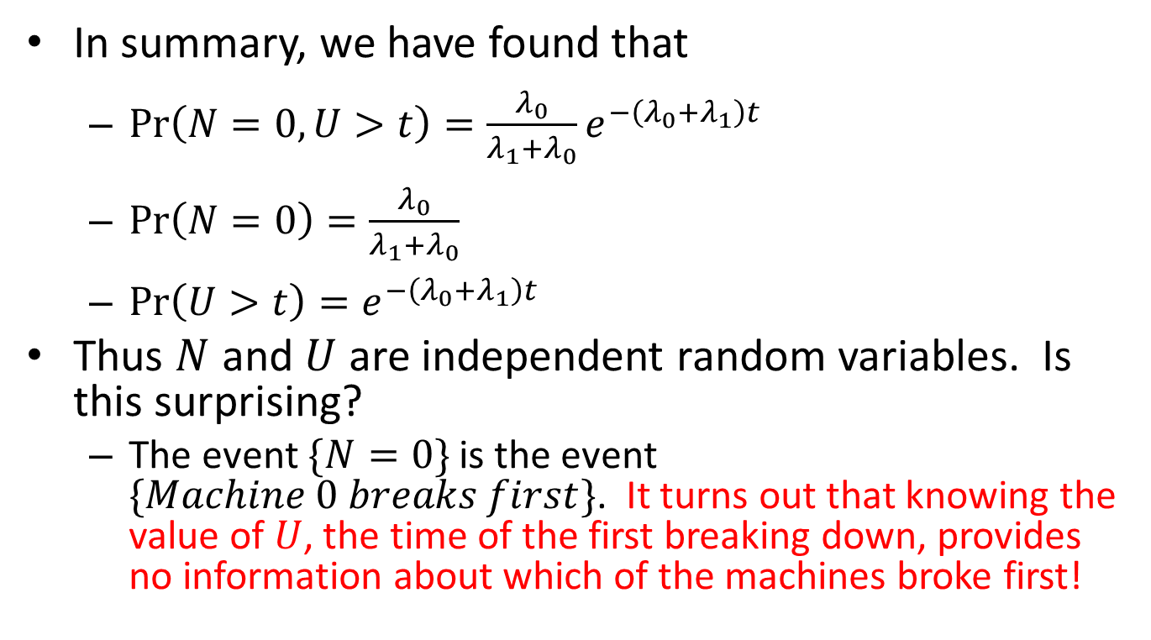
Conditional Probabilities and Expectations
In summary, we have found that
$\operatorname{Pr}\left(N=0, U>t\right)=\frac{λ_{0}}{λ_{1}+λ_{0}}e^{−\left(λ_{0}+λ_{1}\right)t}$
$\operatorname{Pr}\left(N=0\right)=\frac{λ_{0}}{λ_{1}+λ_{0}}$
$\operatorname{Pr}\left(U>t\right)=e^{−\left(λ_{0}+λ_{1}\right)t}$
Thus $N$ and $U$ are independent random variables. Is this surprising?
The event $\{N=0\}$ is the event $\{Machine 0 breaks first\}$. It turns out that knowing the value of $U$, the time of the first breaking down, provides no information about which of the machines broke first!

